Slide 1
INTERNATIONAL ECONOMIS
Course code- ECONA306
Class- BA 3rd year
Discipline Specific Elective
Session -2022-23
Gopal Bhardwaj
Assistant Professor
Dept. of Economics

Slide 2
Chapter 4: Heckscher–Ohlin Model of Comparative Advantage
An Introduction to International Economics: New Perspectives on the World Economy

Slide 3
Introduction
The Heckscher-Ohlin model lies at the heart of the field of trade theory and has shown to have empirical relevance.
Applied trade policy analysis draws on the insights of both the Ricardian and the Heckscher-Ohlin models.

Slide 4
Factors of Production
Definition: types of resources used in production processes
  Appear as independent variables in production functions, with firms’ outputs as dependent variables
  Commonly used: labor, human capital, physical capital (including capital goods), land
Countries differ significantly in their endowments of these factors of production (Fig. 4.1)

Slide 5
Factors of Production
Factor endowments: characterize countries.
Factor intensities: characterize sectors, reflecting the technology associated with sectors across all countries.
  E.g.: Chemicals sector: capital-intensive
  Clothing sector: labor-intensive
  Agricultural sector: natural resources-intensive
In the H-O model, technologies are assumed to be identical across countries.
The interaction of country-based factor endowments with sector-based factor intensities determines patterns of comparative advantage.

Slide 6
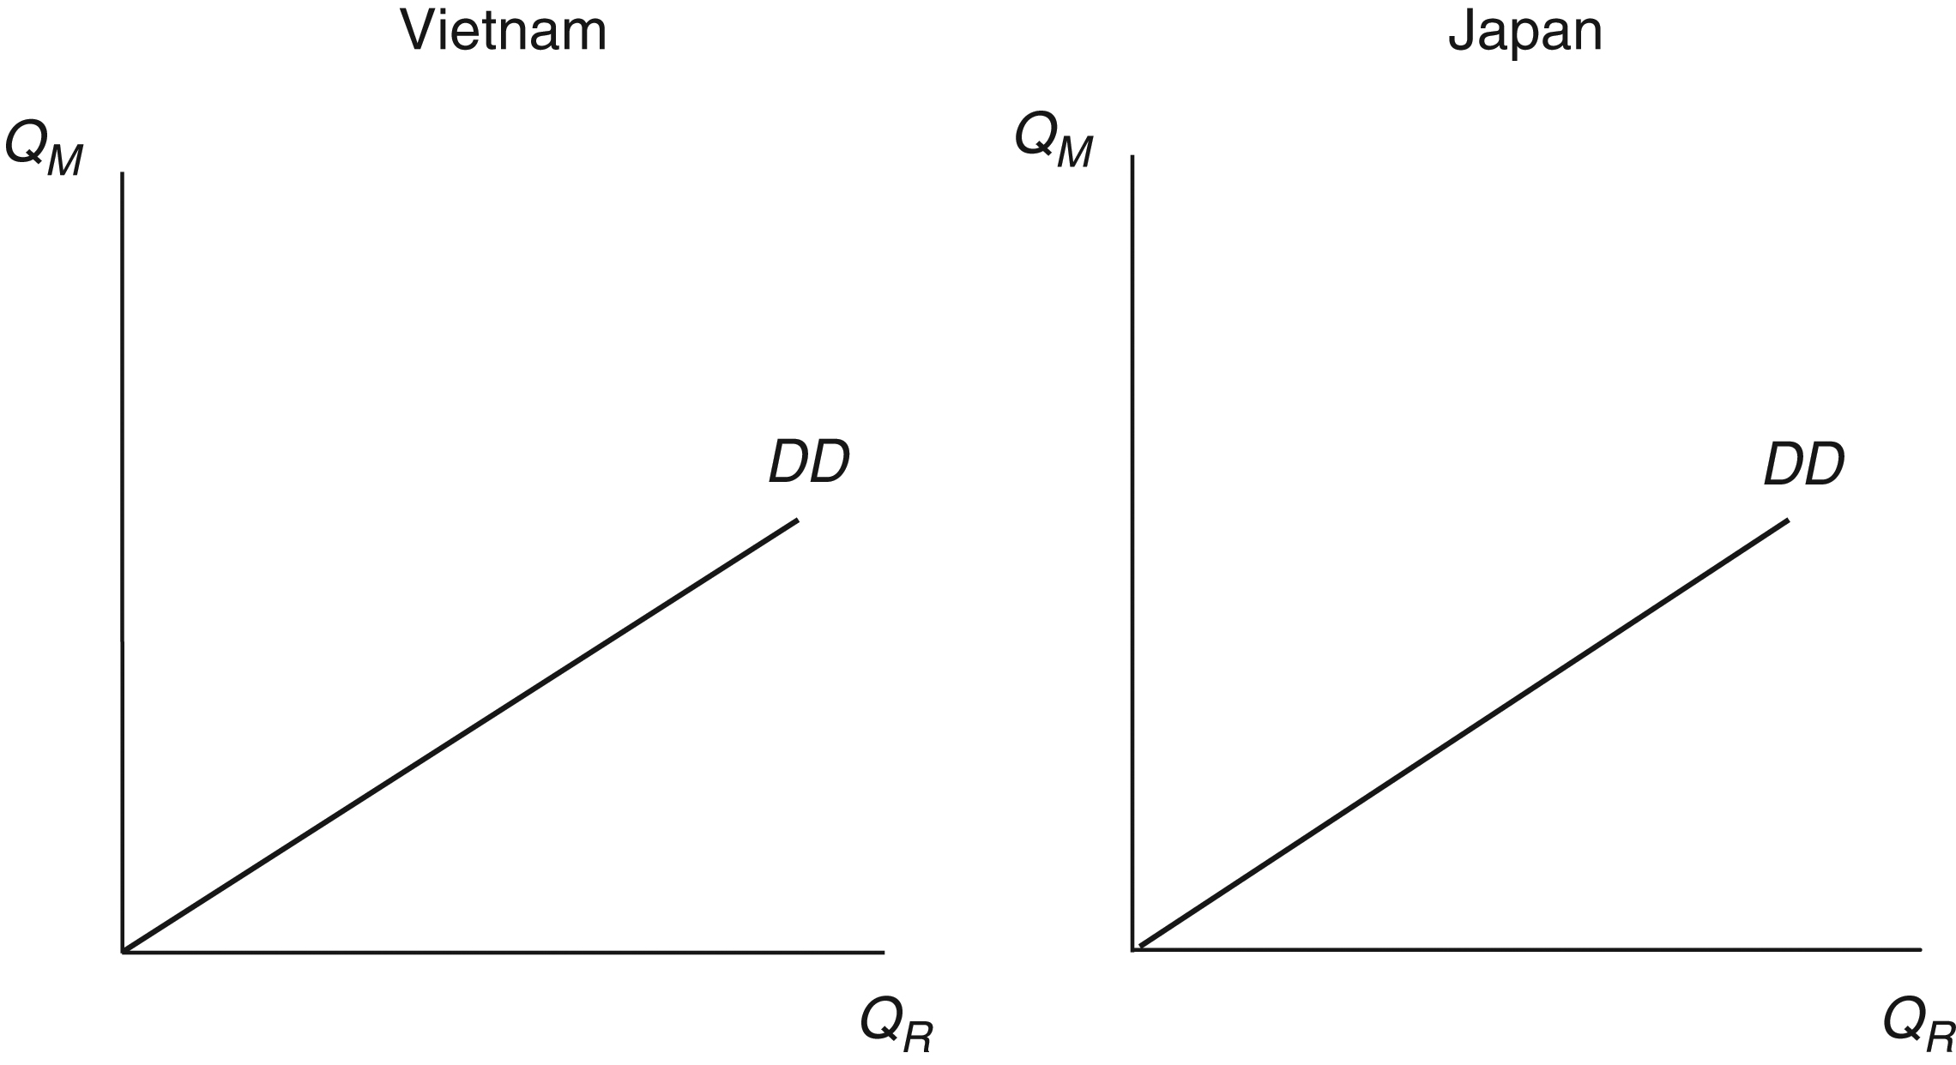
Figure 4.2 Demand diagonals in Vietnam and Japan
Assume that demands for rice and motorcycles in both Vietnam and Japan are such that these two goods are consumed in the same, fixed proportions

Slide 7
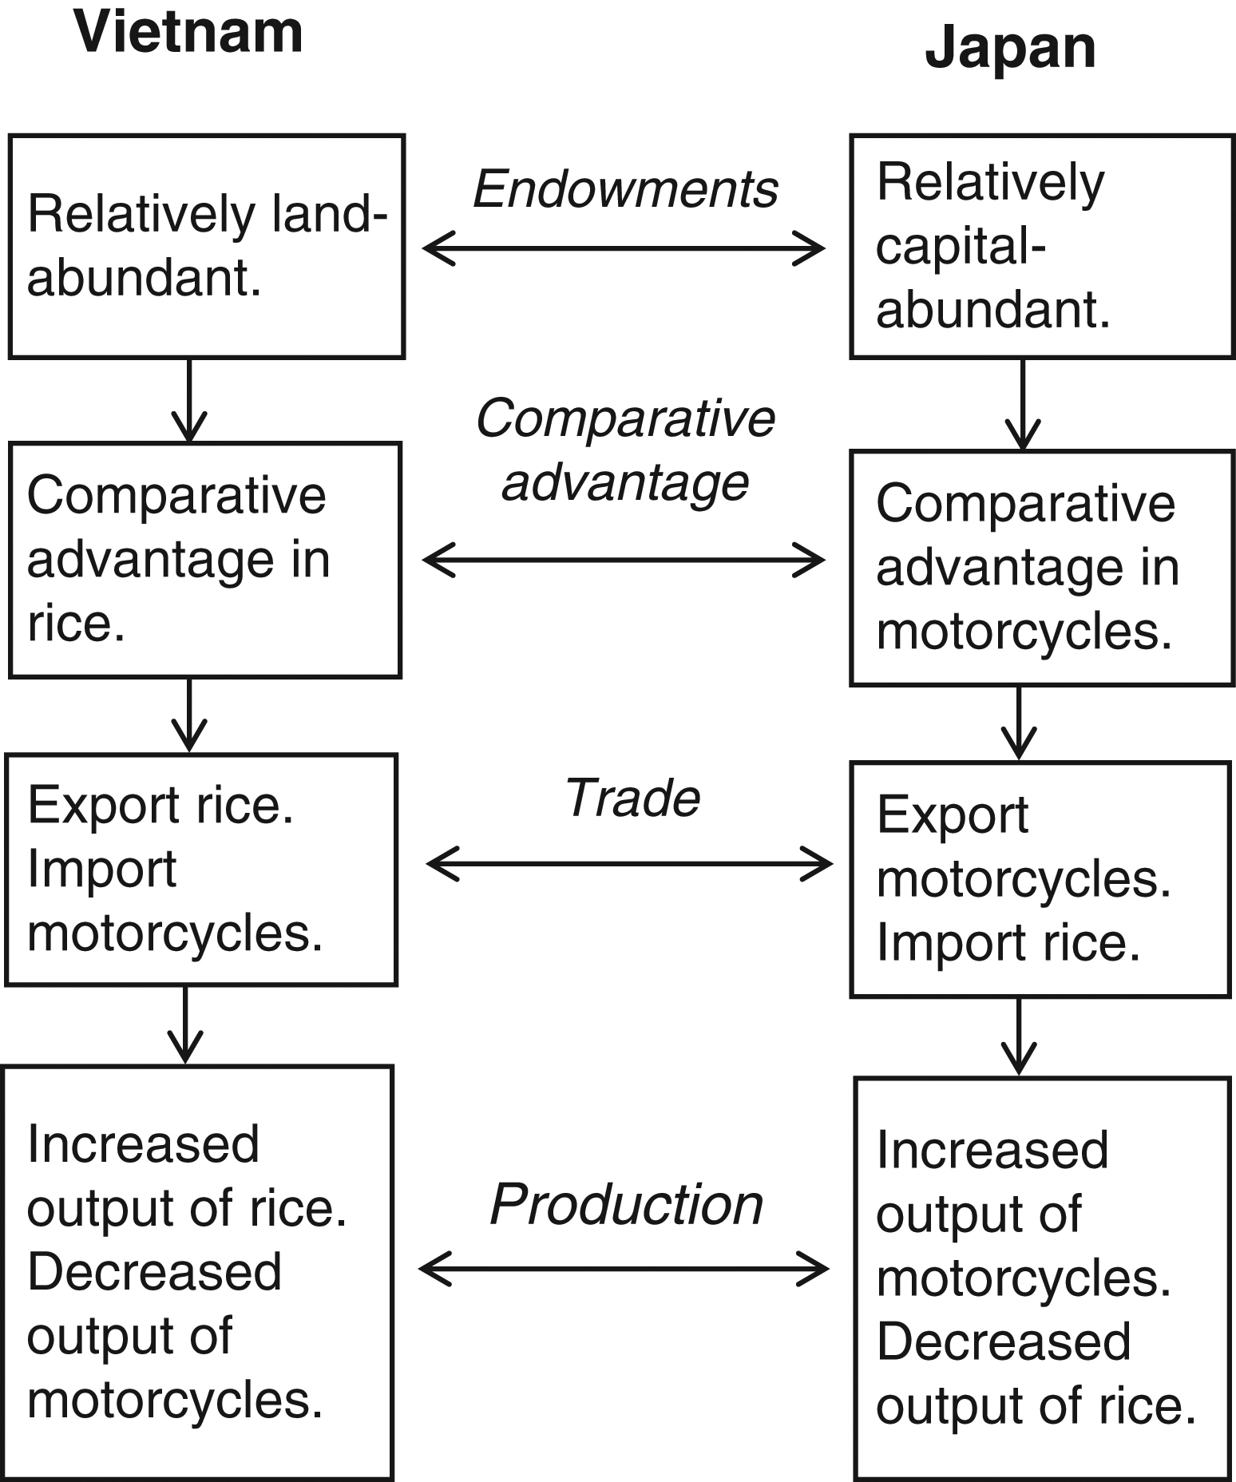
Figure 4.3 The Heckscher–Ohlin model of comparative advantage
A country exports the good whose production is intensive in its abundant
factor. It imports the good whose production is intensive in its scarce factor.

Slide 8
From Factors of Production to Comparative Advantage
Increasing opportunity costs: the two sectors represented have different factor intensities and therefore benefit differently from additional units of the two factors considered
Vietnam: relatively land-abundant
  Gives it a comparative advantage in producing land-intensive goods (rice)
Japan: relatively capital-abundant
  Gives it a comparative advantage in producing capital-intensive goods (motorcycles)

Slide 9
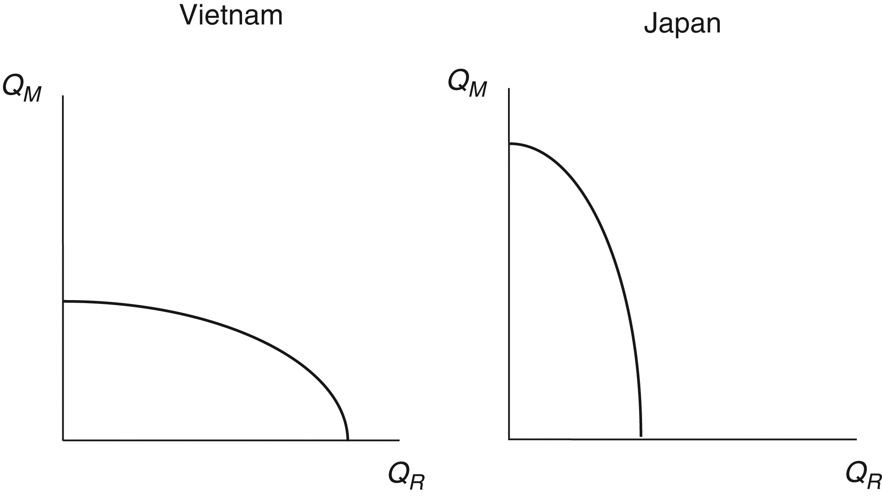
Vietnam is relatively land-abundant, this causes a bias in its PPF towards the land-intensive good rice.
Japan is relative capital-abundant, this causes a bias in its PPFs toward the capital-intensive good motorcycles.
Figure 4.4 Production possibility frontiers in Vietnam and Japan

Slide 10
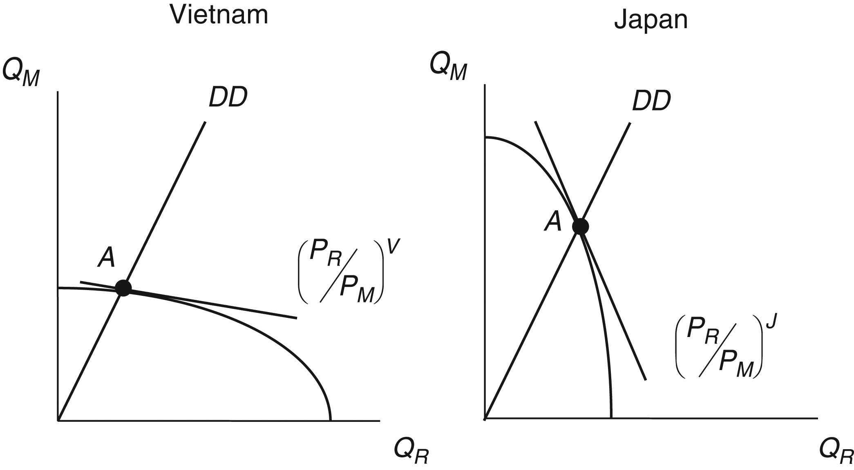
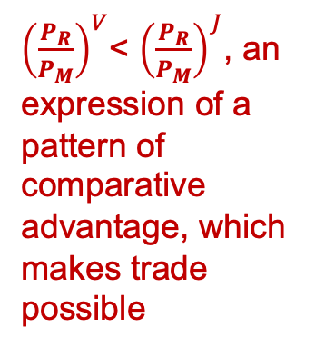
${\left(\frac{P_{R}}{P_{M}}\right)}^{V}$<${\left(\frac{P_{R}}{P_{M}}\right)}^{J}$, an expression of a pattern of comparative advantage, which makes trade possible
Relative price of rice
Figure 4.5 Relative autarky prices in Vietnam and Japan

Slide 11
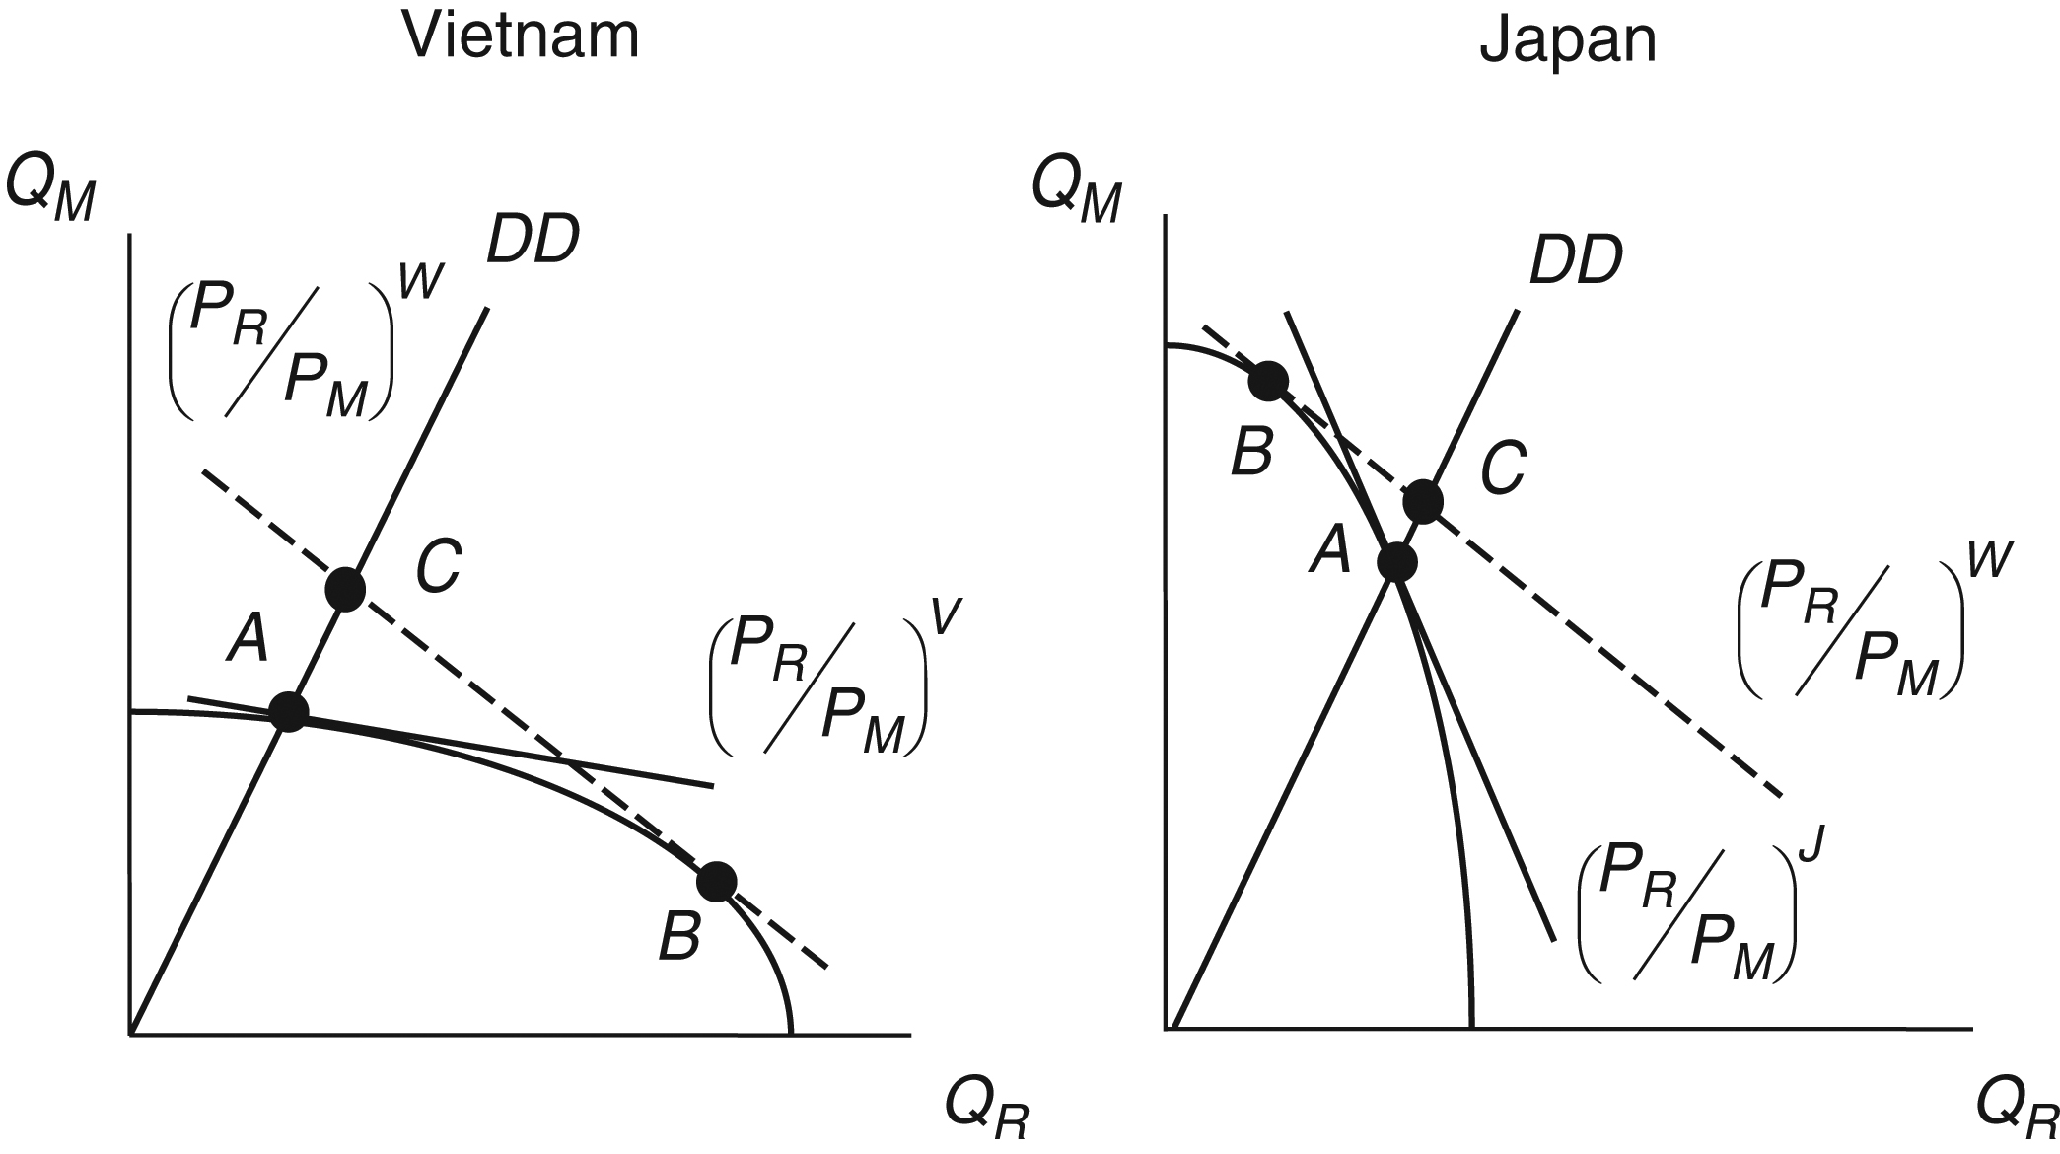
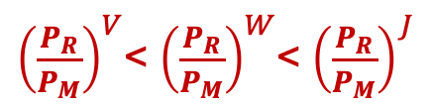
International Trade
In Vietnam, the movement along the PPF from A to B involves increase in the production of rice.
In Japan, this movement involves an increase in the production of motorcycles.
This is known as specialization in production
${\left(\frac{P_{R}}{P_{M}}\right)}^{V}$<${\left(\frac{P_{R}}{P_{M}}\right)}^{W}$<${\left(\frac{P_{R}}{P_{M}}\right)}^{J}$
Figure 4.6 From autarky to trade between Vietnam and Japan

Slide 12
International Trade
Moving from autarky to trade restructures an economy’s production towards the good in which the country has a comparative advantage.
This is one reason why opening economies up to trading relations with the rest of the world can be difficult for the countries involved.
Workers and other resources must be moved from one sector of the economy to another in the process.

Slide 13
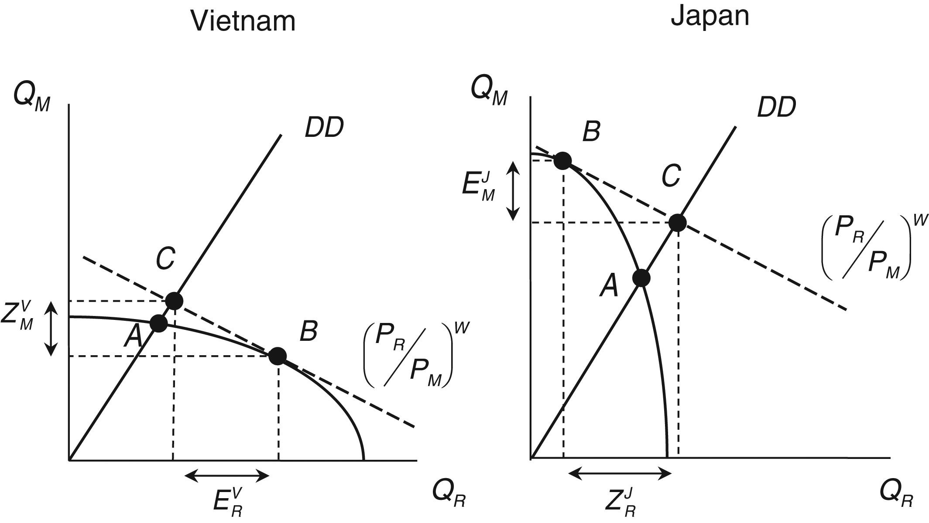
Japan’s export of motorcycles
Vietnam’s import of motorcycles
Vietnam’s export of rice
Japan’s import of rice
Figure 4.7 Trade between Vietnam and Japan

Slide 14
International trade: a summary
Ricardian model Differences in technology-determined supply conditions between the countries of the world give rise to complementary patterns of comparative advantage. These patterns of comparative advantage, in turn, make possible complementary patterns of international trade.
Heckscher–Ohlin model Differences in factor endowments between the countries of the world give rise to complementary patterns of comparative advantage. These patterns of comparative advantage, in turn, make possible complementary patterns of international trade.

Slide 15
Gains from Trade
Movement from autarky to trade increases consumption of both rice and motorcycles
Figure 4.7 Trade between Vietnam and Japan

Slide 16
FDI, Migration, and Comparative Advantage
Both the Ricardian and Heckscher-Ohlin models assume no foreign direct investment and international migration.
But both are important aspects of international economic integration or globalization.

Slide 17
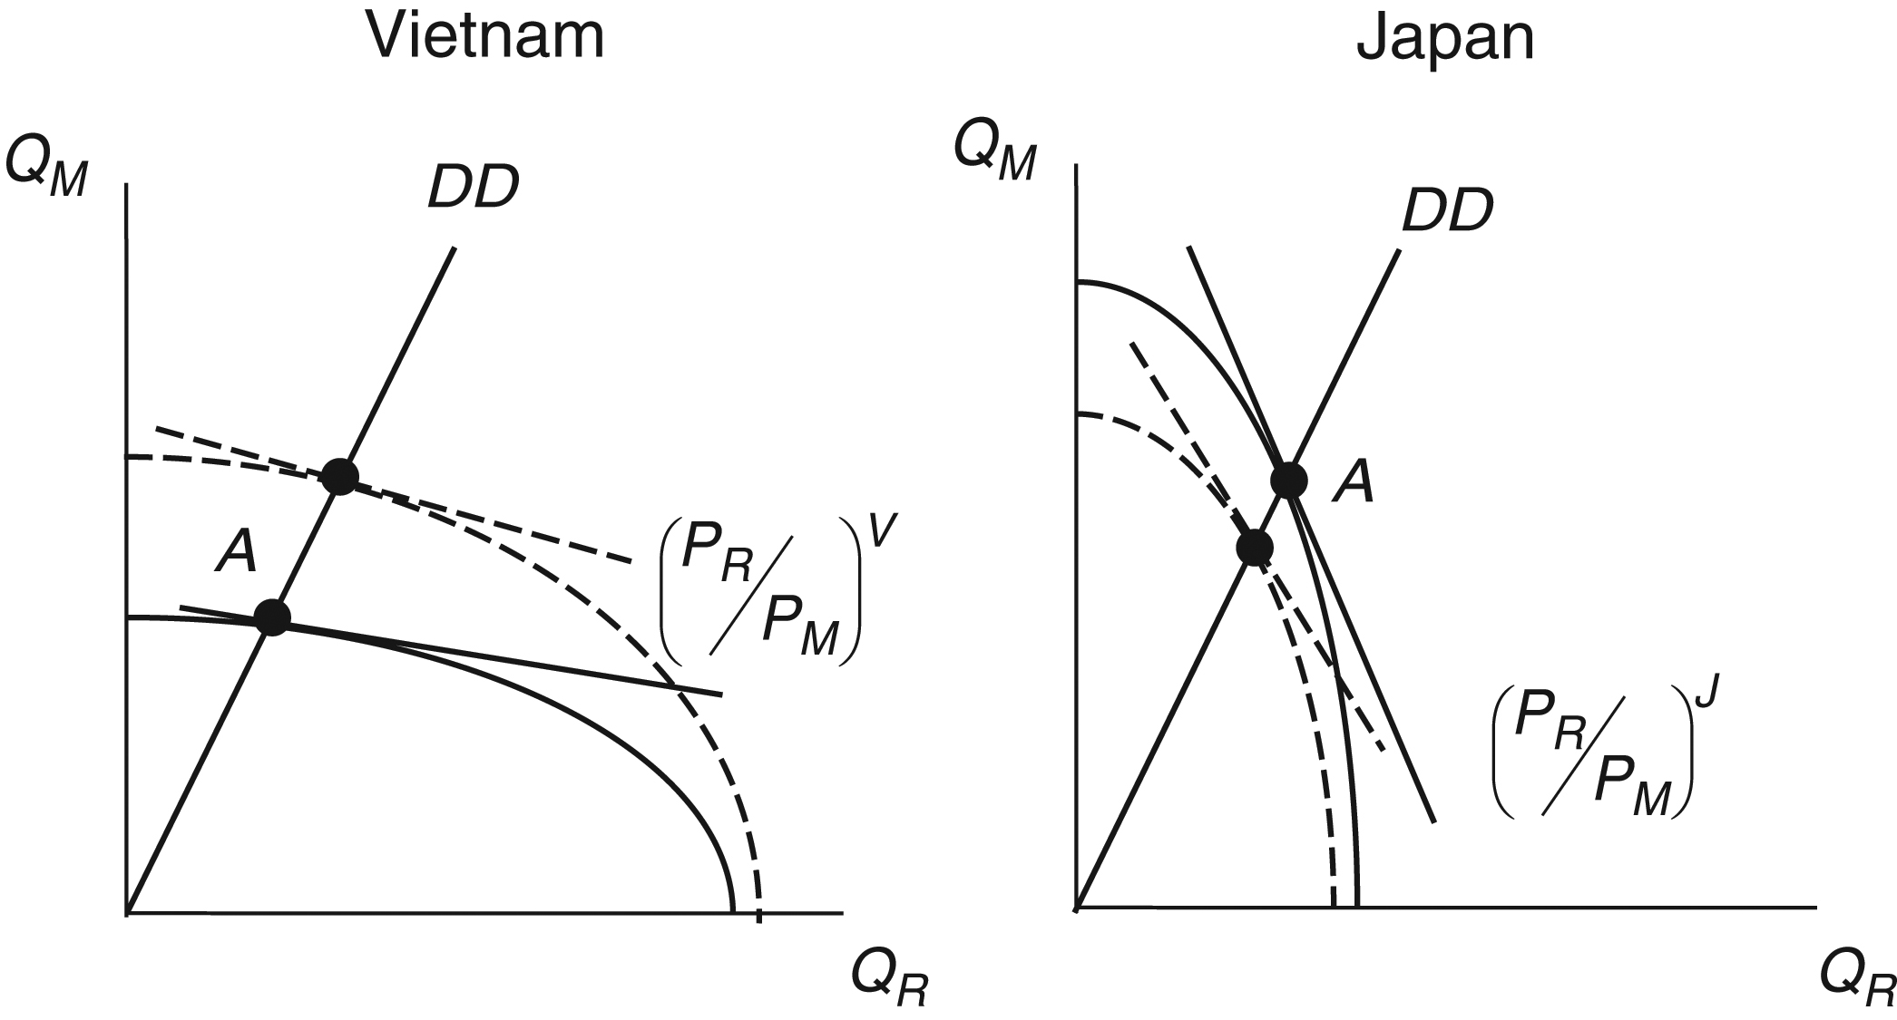
Figure 4.8 FDI and comparative advantage between Vietnam and Japan

Slide 18
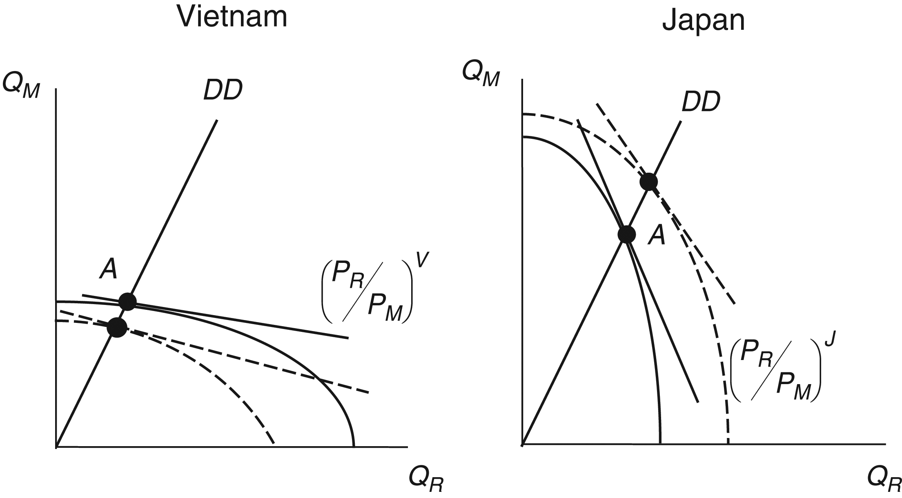
Figure 4.9 Migration and comparative advantage between Vietnam and Japan

Slide 19
Limitations
Heckscher-Ohlin model’s assumptions:
  Only two resources or factors of production. Perfect competition, full employment, and profit maximization. Countries differ from one another in only one way (factor endowments). Technology is the same everywhere.
The gains from trade occur for the country as a whole. Doesn’t mean that every individual or group within the country benefits.
Some goods are traded that do not contribute to increased welfare.
Impacts of trade on the basis of comparative advantage on the environment.

